Slide 1

ANTILLIA
REALTOR LAUNCH · CARIBBEAN
Your listings deserve more than a portal
Antillia turns each mandate into a verified, intelligent and immersive property experience.
THE CARIBBEAN, VERIFIED.
ZOOM LAUNCH EDITION · OCTOBER 2026

Slide 2
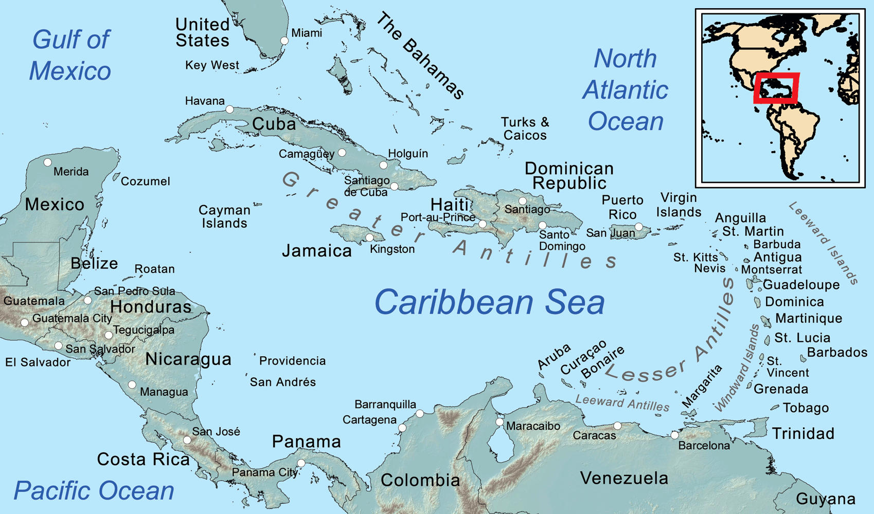
THE OPPORTUNITY
02 / 15
One Caribbean market. Many disconnected buyer journeys.
Antillia gives Realtors one place to publish, explain risk, capture intent and move qualified buyers forward.
Source-linked property presentation
Island-specific buyer intelligence
One private operating desk
ANTILLIA · THE CARIBBEAN, VERIFIED.

Slide 3

YOUR ADVANTAGE
03 / 15
Trust is the product
7
risk areas
Climate resilience
Structural integrity
Security
Tax & legal
Financial
Logistics
Marine access
Evidence is sourced, confidence-rated and honestly labelled when property-level analysis is pending.
ANTILLIA · THE CARIBBEAN, VERIFIED.

Slide 4

PUBLISH WITHOUT FRICTION
04 / 15
Four ways to bring listings to market
01
Create manually
Editable before publication.
02
Paste property links
Editable before publication.
03
Scan a Realtor website
Editable before publication.
04
Invite an owner to submit
Editable before publication.
Possible duplicates are blocked for review.
ANTILLIA · THE CARIBBEAN, VERIFIED.

Slide 5

PREMIUM PRESENTATION
05 / 15
Every listing becomes a complete buyer experience
Exact-property photo gallery
Full details and availability
Map and Google Earth access
Financing and monthly-cost planning
Realtor profile and source provenance
One page. Every next question answered.
ANTILLIA · THE CARIBBEAN, VERIFIED.

Slide 6

IMMERSIVE MEDIA
06 / 15
Let the property travel before the buyer does
True 2:1 panoramas create a full look-around. Room scenes make remote discovery tangible, while flat images remain clearly labelled.
360° TOUR STUDIO
ANTILLIA · THE CARIBBEAN, VERIFIED.

Slide 7

BUYER INTELLIGENCE
07 / 15
Answer the questions behind the enquiry
Destination profiles
Buying steps and cost guidance
CBI links where applicable
Climate and due-diligence research
Market Pulse and island comparison
Home base: Saint Lucia
ANTILLIA · THE CARIBBEAN, VERIFIED.

Slide 8
AI CHIEF OF STAFF
08 / 15
Start each morning knowing what matters
Daily brief with top scored leads
Tasks and follow-ups due soon
Today’s calls and viewings
Office listing and accounting totals
Editable outcomes and completion history
AI guidance — checked by you before acting.
ANTILLIA · THE CARIBBEAN, VERIFIED.

Slide 9
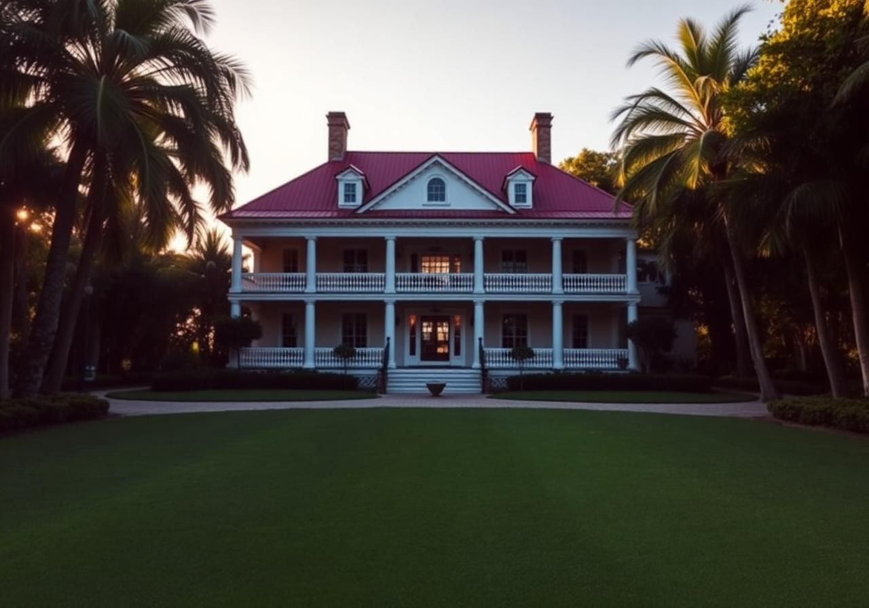
LEAD QUALIFICATION
09 / 15
Turn enquiry signals into the next best action
1–100
AI lead score
Each score includes concise reasoning and one recommended next action. Scores above 80 automatically create a high-priority follow-up task.
ANTILLIA · THE CARIBBEAN, VERIFIED.

Slide 10

PRIVATE DEAL SUPPORT
10 / 15
Move from interest to diligence with control
Lead pipeline and private notes
Calls, viewings and follow-up outcomes
Deal Room milestone checklist
Advisor routing by island and credential
Vault opportunities and document tools
ANTILLIA · THE CARIBBEAN, VERIFIED.

Slide 11
KNOW THE BUSINESS
11 / 15
Property-level accounting, not guesswork
Record commissions and other income
Capture marketing, media, legal and travel expenses
View P&L by property, island group or office
Keep currencies separate
Export CSV or print a PDF report
Commission
EXPENSES
PROFIT
Recorded income
Property-linked costs
Net and margin
ANTILLIA · THE CARIBBEAN, VERIFIED.

Slide 12

YOUR PUBLIC PRESENCE
12 / 15
A professional Caribbean portfolio buyers can explore
Approved listings connect to a public Realtor profile. Office branding, verified inventory and regional context create one consistent presentation.
“Keep your identity. Add intelligence.”
ANTILLIA · THE CARIBBEAN, VERIFIED.

Slide 13
WHY HOST ON ANTILLIA
13 / 15
More confidence at every stage of the sale
01
02
03
Stand apart
Answer sooner
Focus effort
Beyond a flat listing directory.
Context before the first call.
AI-assisted qualification and follow-up.
04
05
Connect the office
Share anywhere
Listings, leads and finances together.
One mobile-ready buyer experience.
ANTILLIA · THE CARIBBEAN, VERIFIED.

Slide 14
YOUR FIRST 30 MINUTES
14 / 15
Join. Verify. Publish. Respond.
1
Create your account
2
Request Realtor verification
3
Complete your profile
4
Publish or import one listing
5
Generate your first brief
ANTILLIA · THE CARIBBEAN, VERIFIED.

Slide 15
ANTILLIA
The Caribbean, verified.
Bring your listings. Keep your identity. Give every serious buyer a more intelligent way to move forward.
antillia.online/realtor-launch
REALTOR USER GUIDE · POWERPOINT · PDF

